Slide 2
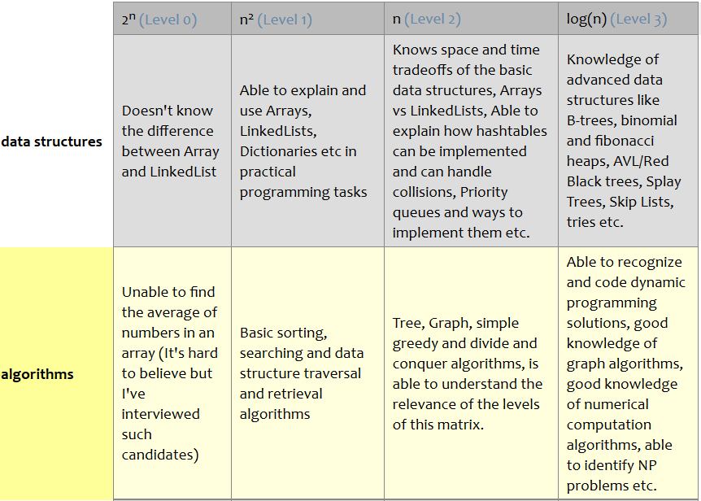
Welcome to CS202!
The world only cares about — and pays off on —
what you can do with
what you know (and it doesn’t care how you learned it)
Laszlo Bock, Senior VP, Google
Source: http://www.starling-software.com/employment/programmer-competency-matrix.html
<number>

Slide 3
Instructor Details and Course Overview
Course in Charge: Co-instructor:
Prof. Viraj Kumar Prof. Madhura V.
viraj.kumar@pes.edu madhura.v.madhu@gmail.com
Office: opp. Room B-301 Office: Staff Room (Ground Flr)
Course policies:
T1 and T2 are computer-based and worth 15% each
Comprehensive Final is written and worth 40%
One A4-sized handwritten cheat-sheet allowed on all exams
T3 policy
Project (groups of 2 or 3, no exceptions): Part 1 (5%) and Part 2 (20%)
Cheating Policy: Any attempt to pass off someone else’s work as your own, or to assist someone else (actively or passively) in such an effort, is considered cheating. The penalty for any such offence will be zero for all involved students.
<number>

Slide 4
Course Project: Two Options
Fast track: Complete project in Data Structures Made Easy (UCSD); coursera.org/learn/data-structures-optimizing-performance (Java)
NOT: coursera.org/learn/data-structures
Register by Aug 6, complete work by Sept 11, viva date TBA
Regular track: Complete in-course project (any language other than C)
Can combine this with other course projects (e.g., Web Tech.)
Common concept: Edit Distance between two words (operations allowed: insert, modify, delete one letter at a time)
e.g., time → stime → spime → spame → space (edit distance = 4)
A twist: intermediate words must be valid English words (vocab. game)
time → tame → fame → face → pace → space (edit distance = 5)
<number>

Slide 5
Course Project: Two Options
Fast track: Complete project in Data Structures Made Easy (UCSD); coursera.org/learn/data-structures-optimizing-performance (Java)
NOT: coursera.org/learn/data-structures
Register by Aug 6, complete work by Sept 11, viva date TBA
Regular track: Complete in-course project (any language other than C)
Can combine this with other course projects (e.g., Web Tech.)
Common concept: Edit Distance between two words (operations allowed: insert, modify, delete one letter at a time)
e.g., time → stime → spime → spame → space (edit distance = 4)
A twist: intermediate words must be valid English words (vocab. game)
time → tame → fame → face → pace → space (edit distance = 5)
<number>

Slide 6

Data Structures in C
IEEE Spectrum: Top Programming Languages, July 26, 2016
spectrum.ieee.org/static/interactive-the-top-programming-languages-2016
After two years in second place, C has finally edged out Java for the top spot. Staying in the top five, Python has swapped places with C++ to take the No. 3 position, and C# has fallen out of the top five to be replaced with R.
<number>
Notes:
<number>

Slide 7
Recursion
What happens when this program is compiled and run?
#include <stdio.h>
int f(int *a, int n) {
if(n == 0) { return 0; }
return a[n-1];
}
int main() {
int array[3] = {1, 2, -3};
printf("%d\n", f(array, 3));
return 0;
}
Now, let us make one modification
What is in <stdio.h>?
Pass by value? reference?
Else needed?
Address calculation
+ f(a, n-1);
f
a = array, n = 2
S
t
a
c
k
f
a = array, n = 3
main
arguments
return address
local vars
Loader
<number>
Notes:
<number>

Slide 8
Structures and Pointers
A company is hiring, and wants to make relevant data of shortlisted candidates available to interviewers
in memory
typedef struct student {
double gpa;
char *github;
} student_t;
#define MAX_STUDENTS 100
int main() {
student_t list[100];
return 0;
}
Header file (.h)
list[MAX_STUDENTS];
<number>
Notes:
<number>

Slide 9
Structures and Pointers
A company is hiring, and wants to make relevant data of shortlisted candidates available to interviewers
in memory
typedef struct student {
double gpa;
char *github;
} student_t;
#define MAX_STUDENTS 100
int main() {
student_t list[100];
return 0;
}
Header file (.h)
list[MAX_STUDENTS];
<number>
Notes:
<number>

Slide 10
Main program expanded
typedef struct student {
double gpa;
char *github;
} student_t;
#define MAX_STUDENTS 100
double get_gpa(student_t *, int);
int main() {
student_t list[MAX_STUDENTS];
int i;
printf("Enter student no. "); scanf("%d", &i);
printf("GPA is: %lf\n", list[i].gpa);
return 0;
}
Details abstracted away
in a header file (.h)
get_gpa(list, i));
Key point: Tomorrow, if I change the
way I organize my data, I will need to
change lots of lines of code like this.
<number>
Notes:
<number>

Slide 11
Interface/Abstraction
Once the client and implementer agree on an interface (a.k.a. abstraction):
the client is free to write any code using the interface functionality
the implementer is free to modify the implementation
neither group needs to inform the other!
You will see this idea all over CS:
Client code
Interface
Implementation
Software
Instruction Set
Architecture
Hardware
<number>

Slide 12
Code for get_gpa
double get_gpa(student_t *list, int i) {
return list[i].gpa;
}
Question: What if index i is out of bounds?
// BREAKS agreed-upon function prototype!
int get_gpa(student_t *list, int i, double *g) {
if(i < 0 || i >= MAX_STUDENTS) { return 0; }
*g = list[i].gpa;
return 1;
}
Complete the set_gpa implementation
Write the prototype for get_github and
then write the implementation
printf("Enter student no. "); scanf("%d", &i);
double g;
if(get_gpa(list, i, &g)) {
printf("GPA is: %lf\n", g);
} else { ... }
<number>
Notes:
<number>

Slide 13
Code for set_github
Your friend wrote this function − critique it:
void set_github(student_t *list, int i, char *gh) {
list[i].github = gh;
}
Suppose the main function contains:
int main() {
student_t list[MAX_STUDENTS];
char URL[20];
scanf("%s", URL); set_github(list, 0, URL);
scanf("%s", URL); set_github(list, 1, URL);
return 0;
}
<number>
Notes:
<number>

Slide 14
Corrected (?) code for set_github
void set_github(student_t *list, int i, char *gh) {
int len = strlen(gh);
list[i].github = (char *) malloc(len);
int j;
for(j = 0; j < len; ++j) {
list[i].github[j] = gh[j];
}
}
Freeing memory:
void free_memory(student_t *list) {
for(int i = 0; i < MAX_STUDENTS; ++i) {
free(list[i].github);
}
}
+ 1;
*sizeof(char));
strncpy(list[i].github, gh, len);
<number>
Notes:
<number>

Slide 15
Pointers to functions
The free_memory function we just wrote has this structure:
for all array elements
do something with element i // “do something” = “free github”
Similarly, we may wish to initialize all data, print all data, …
Would like to do this:
void forall(student_t *list) {
for(int i = 0; i < MAX_STUDENTS; ++i) {
task( list[i] ); // where task can be "anything"
}
}
&
Two problems:
We need to make task an argument to forall
If task modifies list[i], then we must pass a pointer to list[i] (a good idea anyway − why?)
<number>
Notes:
<number>

Slide 16
Pointers to functions: syntax
base address
pointer to i^{th} element
void forall(student_t *list, void (*task)(student_t *)) {
for(int i = 0; i < MAX_STUDENTS; ++i) {
task(&list[i]); // no need to say *task
}
}
void init_task(student_t *s) {
s->gpa = 0.0; // same as: (*s).gpa = 0.0;
s->github = NULL;
}
void free_task(student_t *s) {
if(s->github) {
free(s->github);
s->github = NULL;
}
}
int main() {
...
forall(list, init_task);
...
forall(list, free_task);
return 0;
}
<number>
Notes:
<number>

Slide 17
A more advanced forall
student_t *forall(student_t *list,
int (*task)(student_t *, void *)
void *arg) {
for(int i = 0; i < MAX_STUDENTS; ++i) {
if(!task(&list[i], arg)) {
return &list[i];
}
}
return NULL;
}
int sum(student_t *s, void *arg) {
double *total = (double *) arg;
*total = *total + s->gpa;
return 1;
}
int find(student_t *s, void *arg) {
char *gh = (char *) arg;
return strcmp(s->github, gh);
}
double total = 0.0;
forall(list, sum, &total);
student_t *s = forall(list, find, "CoolCoder");
if(s) { printf("%lf\n", s->gpa); }
<number>
Notes:
<number>

Slide 18
Lists
A List is a finite sequence of values
may be empty
duplicate entries allowed, and order matters (unlike a Set)
each list item has a position (we will start numbering from 0)
For C code:
gcc –c implementation.c
gcc –c client.c
gcc client.o implementation.o (linking)
Client code
Can be compiled
and distributed
separately!
List ADT
Header file
(List.h)
Implementation
implementation.o
client.o
<number>
Notes:
<number>

Slide 19
A List ADT
There should be a way to:
create an initially empty list
delete a list (i.e., free up any dynamically allocated memory)
determine whether a list is empty (more generally: its size)
insert an element at position i (special cases: append, prepend)
delete first/last/all occurrence(s) of some data
determine the first/last list entry at which some data appears
read/write the data in that list entry
find the position (starting from 0) at which some data first appears
check if two lists are equal (as sequences)
iterate through the list
perform a given task on all items in the list
Some languages (e.g., Python) support lists with these features and more
<number>
Notes:
<number>

Slide 20
List.h: First Attempt
#ifndef LIST_H
#define LIST_H
typedef void* List;
// create an initially empty list: we will use NULL
// delete a list (and free up any associated memory)
void freeList(List list);
#endif
Solution: Pointer to IMPLementation (PIMPL)
see: http://stackoverflow.com/questions/8972588/is-the-pimpl-idiom-really-used-in-practice
Need to define type for List…
…which defeats the purpose!
<number>
Notes:
<number>

Slide 21
List.h (partial)
#ifndef LIST_H
#define LIST_H
typedef void* ListEntry;
void setData(ListEntry, int);
int getData(ListEntry);
typedef void* List;
void freeList(List);
int isEmpty(List);
int size(List);
List append(List, int);
int findPosition(List, int);
ListEntry start(List);
ListEntry next(List, ListEntry);
ListEntry forall(List, int(*task)(int, void*), void*);
#endif
<number>
Notes:
<number>

Slide 22
List Implementation 1: fixed-size array
Idea: We will represent the list using an array of fixed size (say 1000)
What if we try to append more than 1000 items?
List append(List, int);
we will return NULL to indicate failure
#ifndef ARRAYLIST1_H
#define ARRAYLIST1_H
#define FIXED_SIZE 1000
typedef struct arraylist {
int array[FIXED_SIZE];
int listSize;
} ArrayList;
#endif
36 | −417 | … | 5516 | … | 341
listSize
Client:
List myList = NULL;
…
List newList =
append(myList, 5);
if(newList != NULL) {
myList = newList;
} else { ... }
<number>
Notes:
<number>

Slide 23
List.h (partial)
#ifndef LIST_H
#define LIST_H
typedef void* ListEntry;
void setData(ListEntry, int);
int getData(ListEntry);
typedef void* List;
void freeList(List);
int isEmpty(List);
int size(List);
List append(List, int);
int findPosition(List, int);
ListEntry start(List);
ListEntry next(List, ListEntry);
ListEntry forall(List, int(*task)(int, void*), void*);
#endif
<number>
Notes:
<number>

Slide 24
List Implementation 1: fixed-size array
Idea: We will represent the list using an array of fixed size (say 1000)
What if we try to append more than 1000 items?
List append(List, int);
we will return NULL to indicate failure
#ifndef ARRAYLIST1_H
#define ARRAYLIST1_H
#define FIXED_SIZE 1000
typedef struct arraylist {
int array[FIXED_SIZE];
int listSize;
} ArrayList;
#endif
36 | −417 | … | 5516 | … | 341
listSize
Client:
List myList = NULL;
…
List newList =
append(myList, 5);
if(newList != NULL) {
myList = newList;
} else { ... }
<number>
Notes:
<number>

Slide 25
append
ArrayList *toArrayList(List list) {
ArrayList *this = (ArrayList *) list;
if(this != NULL) { return this; }
if( (this = (ArrayList *) malloc(sizeof(ArrayList)))
!= NULL) {
this->listSize = 0;
}
return this;
}
List append(List list, int data) {
ArrayList *this = toArrayList(list);
if(this == NULL) {
return NULL;
}
this->array[this->listSize] = data;
this->listSize++;
return this;
}
ArrayList *this = (ArrayList *) list;
|| this->listSize == FIXED_SIZE) {
<number>
Notes:
<number>

Slide 26
freeList, isEmpty, size and findPosition
void freeList(List list) {
if(list != NULL) { free(list); }
}
int isEmpty(List list) {
return list == NULL;
}
int size(List list) {
if(list == NULL) { return 0; }
return ((ArrayList *) list)->listSize;
}
int findPosition(List list, int data) {
if(list != NULL) {
ArrayList *this = (ArrayList *) list;
for(int i = 0; i < this->listSize; ++i)
if(this->array[i] == data) { return i; }
}
return -1;
}
|| ((ArrayList *) list)->listSize
== 0;
<number>
Notes:
<number>

Slide 27
prepend
List prepend(List list, int data) {
ArrayList *this = toArrayList(list);
if(this == NULL || this->listSize == FIXED_SIZE) {
return NULL;
}
// copy → and free up array[0]
for(int i = this->listSize; i > 0; --i) {
this->array[i] = this->array[i-1];
}
this->array[0] = data;
this->listSize++;
return this;
}
<number>
Notes:
<number>

Slide 28
prepend
List prepend(List list, int data) {
ArrayList *this = toArrayList(list);
if(this == NULL || this->listSize == FIXED_SIZE) {
return NULL;
}
// copy → and free up array[0]
for(int i = this->listSize; i > 0; --i) {
this->array[i] = this->array[i-1];
}
this->array[0] = data;
this->listSize++;
return this;
}
<number>
Notes:
<number>

Slide 29
insertAt
List insertAt(List list, int data, int i) {
ArrayList *this = toArrayList(list);
if(this == NULL || this->listSize == FIXED_SIZE
|| i < 0 || i > this->listSize) {
return NULL;
}
// copy → and free up array[i]
for(int j = this->listSize; j > i; --j) {
this->array[j] = this->array[j-1];
}
this->array[i] = data;
this->listSize++;
return this;
}
) {
List prepend(List list, int data) {
return insertAt(list, data, 0);
}
<number>
Notes:
<number>

Slide 30
Try one: deleteAt
List deleteAt(List list, int i) {
ArrayList *this = (ArrayList *) list;
if(this == NULL || i < 0 || i >= this->listSize) {
return NULL;
}
if(data != NULL) { *data = this->array[i]; }
// copy ← and overwrite array[i]
for(int j = i+1; j < this->listSize; ++j) {
this->array[j-1] = this->array[j];
}
this->listSize--;
return this;
}
, int *data) {
<number>
Notes:
<number>

Slide 31
Find the bug: deleteAll
List deleteAll(List list, int data) {
if(list == NULL) { return NULL; }
ArrayList *this = (ArrayList *) list;
for(int i = 0; i < this->listSize; ++i) {
if(this->array[i] == data) {
this = deleteAt(this, i, NULL);
}
}
return this;
}
<number>
Notes:
<number>

Slide 32
A better deleteAll?
List deleteAll(List list, int data) {
if(list == NULL) { return NULL; }
ArrayList *this = (ArrayList *) list;
ArrayList *result = NULL;
for(int i = 0; i < this->listSize; ++i) {
if(this->array[i] != data) {
result = append(result, this->array[i]);
}
}
freeList(this);
return result;
}
“most of the work”
“cheap”
Differences
if(this->array[i] == data) {
this = deleteAt(this, i, NULL);
}
Space-Time
Tradeoff
“expensive”
<number>
Notes:
<number>

Slide 33
start, next
ListEntry start(List list) {
if(list == NULL) { return NULL; }
return ((ArrayList *) list)->array;
}
ListEntry next(List list, ListEntry current) {
if(list == NULL || current == NULL) { return NULL; }
ArrayList *this = (ArrayList *) list;
int *curr = (int *) current;
return curr + 1 < (this->array + this->listSize) ?
curr + 1 : NULL;
}
<number>
Notes:
<number>

Slide 34
List Implementation 2: dynamically allocated array
Idea: If the array fills up, we will reallocate a larger block and copy data
Homework: Carefully read the specification of realloc
36 | −417 | … | 5516
listSize
<number>
Notes:
<number>

Slide 35
List Implementation 2: dynamically allocated array
Idea: If the array fills up, we will reallocate a larger block and copy data
#ifndef ARRAYLIST2_H
#define ARRAYLIST2_H
#define INITIAL_SIZE 16
typedef struct arraylist {
int *array;
int size; // how big the array is
int listSize; // how much of it is used
} ArrayList;
#endif
36 | −417 | … | 5516
listSize
<number>
Notes:
<number>

Slide 36
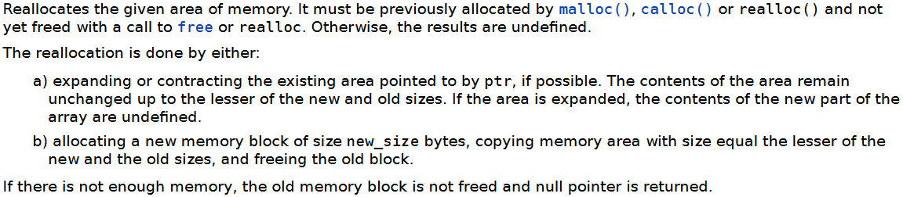
toArrayList
ArrayList *toArrayList(List list) {
ArrayList *this = (ArrayList *) list;
if(this == NULL) { // malloc
if((this = (ArrayList *) malloc(sizeof(ArrayList))) != NULL) {
this->listSize = 0;
if((this->array = (int*)malloc(INITIAL_SIZE*sizeof(int)))!=NULL) {
this->size = INITIAL_SIZE;
} else {
free(this);
this = NULL;
}
}
} else if(this->listSize == this->size) { // realloc
int newSize = 2*(this->size);
int *newArray = (int *) realloc(this->array, newSize * sizeof(int));
if(newArray == NULL) { return NULL; }
this->array = newArray;
this->size = newSize;
}
return this;
}
Recursive definition!
Formal definition of realloc
void *realloc(void *ptr, size_t new_size);
<number>
Notes:
<number>

Slide 37
append, freeList
List append(List list, int data) {
ArrayList *this = toArrayList(list);
if(this == NULL) {
return NULL;
}
this->array[this->listSize] = data;
this->listSize++;
return this;
}
void freeList(List list) {
if(list != NULL) {
free(((ArrayList *) list)->array);
free(list);
}
}
|| this->listSize == FIXED_SIZE) {
<number>
Notes:
<number>

Slide 38
List Implementation 3: linked lists
Definition: A linked list is either empty or consists of a node containing data followed by a linked list
#ifndef LINKEDLIST1_H
#define LINKEDLIST1_H
typedef struct node {
int data;
struct node *next;
} Node;
#endif
Recursive
In LinkedList.c
Node *makeNode(int data, Node *next) {
Node *newNode = (Node *) malloc(sizeof(Node));
if(newNode != NULL) {
newNode->data = data;
newNode->next = next;
}
return newNode;
}
<number>
Notes:
<number>

Slide 39
prepend, size, isEmpty
List prepend(List list, int data) {
return makeNode(data, (Node *) list);
}
int size(List list) {
int result = 0;
for(Node *p = (Node *) list; p != NULL; p = p->next)
++result;
return result;
}
int isEmpty(List list) { return list == NULL; }
if(list == NULL) { return 0; }
return 1 + size(((Node *) list)->next);
<number>
Notes:
<number>

Slide 40
append
List append(List list, int data) {
Node *newNode = makeNode(data, NULL);
if(newNode == NULL || list == NULL) { return newNode; }
Node *p = (Node *) list;
while(p->next != NULL) {
p = p->next;
}
p->next = newNode;
return list;
}
In LinkedList1: prepend is cheap,
size and append are expensive
In ArrayList1: prepend is expensive,
size and append are cheap
In ArrayList2: size is cheap, append
and prepend are expensive (in the
worst case)
In LinkedList2: all 3 will be cheap!
<number>
Notes:
<number>

Slide 41
start, next, getEntry, setEntry
ListEntry start(List list) { return list; }
ListEntry next(List list, ListEntry current) {
return current == NULL ? NULL :
((Node *) current)->next;
}
int getData(ListEntry e) { return ((Node *) e)->data; }
void setData(ListEntry e, int data) {
((Node *) e)->data = data;
}
<number>
Notes:
<number>

Slide 42
findPosition, deleteAll
int findPosition(List list, int data) {
Node *p = (Node *) list;
for(int i = 0; p != NULL; p = p->next, ++i) {
if(p->data == data) { return i; }
}
return -1;
}
List deleteAll(List list, int data) {
if(list == NULL) { return NULL; }
Node *p = (Node *) list;
Node *rec = (Node *) deleteAll(p->next, data);
if(p->data == data) { free(p); return rec; }
p->next = rec;
return p;
}
// Find the bug!
if(list == NULL) { return -1; }
Node *p = (Node *) list;
if(p->data == data) { return 0; }
return 1 + findPosition(p->next, data);
<number>
Notes:
<number>

Slide 43
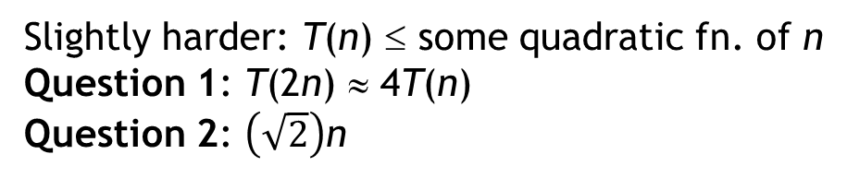
Asymptotic Analysis
“Performance” of operations on data structures (in general) depends on the size n of the data structure
“performance” usually means “time”, but “space” is also important
Notation: T(n) = time to do operation on data structure of size n
Key idea: It is worth studying how T(n) grows for large values of n
Question 1: If we double the data size (n → 2n), then T(n) → ?
Question 2: If tomorrow we have a computer that is twice as fast and we keep the time T(n) = t fixed, how much larger can n become?
Easy case: T(n) ≤ some linear function of n (notation: T(n) is O(n))
Question 1: T(2n) ≈ 2T(n) // for large n, regardless of coefficients!
Question 2: 2n
may be hard to get an exact bound
An O(n) running
time will scale
better than O(n²)
Slightly harder: T(n) ≤ some quadratic fn. of n
Question 1: T(2n) ≈ 4T(n)
Question 2: n
<number>
Notes:
<number>

Slide 44
Comparison of implementations
We have seen three List implementations: ArrayList 1 & 2, LinkedList1
Notes:
“Running time is O(1)” means “running time is at most a constant, regardless of n”
ArrayList1’s append takes O(1) time (fails after FIXED_SIZE reached!)
ArrayList2’s append takes O(n) time in the worst case (it takes O(1) time most of the time)
For deleteAt in arrays, we can get to the deleting position i in O(1) time, but it takes O(n) time to “fill the hole”. For linked lists, getting to position i takes O(n) time, but removing the node takes O(1) time
 | ArrayList1 | ArrayList2 | LinkedList1
prepend | O(n)
append | O(1)
insertAt | O(n)
deleteAt | O(n)
deleteAll | Next slide | Next slide | Next slide
findPosition | O(n)
O(n)
O(n)
O(n)
O(n)
O(n)
O(1)
O(n)
O(n)
O(n)
O(n)
<number>
Notes:
<number>

Slide 45
Two versions of deleteAll
List deleteAll(List list, int data) {
if(list == NULL) { return NULL; }
ArrayList *this = (ArrayList *) list;
ArrayList *result = NULL;
for(int i = 0; i < this->listSize; ++i) {
if(this->array[i] != data) {
result = append(result, this->array[i]);
}
}
freeList(this);
return result;
}
For ArrayList2
O(1)
+ n × O(n)
+ O(1)
which is O(n²)
For ArrayList1
O(1)
+ n × O(1)
+ O(1)
which is O(n)
“most of the work”
“cheap”: O(1)
Differences
if(this->array[i] == data) {
this = deleteAt(this, i, NULL);
}
Space-Time
Tradeoff
“expensive”: O(n)
O(n) time and O(n) extra space
vs. O(n²) time and O(1) extra space
<number>
Notes:
<number>

Slide 46
deleteAll in LinkedList1
List deleteAll(List list, int data) {
if(list == NULL) { return NULL; }
Node *this = (Node *) list;
for(Node *p = this; p->next != NULL; p = p->next) {
if(p->next->data == data) {
Node *q = p->next;
p->next = q->next;
free(q);
}
}
if(this->data == data) {
Node* p = this;
this = p->next;
free(p);
}
return this;
}
O(n) time and O(1) extra space!
<number>
Notes:
<number>

Slide 47
List Implementation 4: LinkedList2
#ifndef LINKEDLIST2_H
#define LINKEDLIST2_H
typedef struct node {
int data;
struct node *next;
} Node;
typedef struct linkedlist {
Node *head;
Node *tail;
int listSize;
} LinkedList;
#endif
 | LinkedList2
prepend | O(1)
append | O(1)
insertAt | O(n)
deleteAt | O(n)
deleteAll | O(n)
findPosition | O(n)
size | O(1)
head
tail
<number>
Notes:
<number>

Slide 48
append in O(1) time
List append(List list, int data) {
Node *newNode = makeNode(data, NULL);
if(newNode == NULL) { return NULL; }
LinkedList *this = toLinkedList(list);
if(this == NULL) {
free(newNode);
return NULL;
}
if(this->listSize == 0) {
this->head = this->tail = newNode;
} else {
this->tail = this->tail->next = newNode;
}
this->listSize++;
return this;
}
like toArrayList
<number>
Notes:
<number>

Slide 49


Research Paper
B. Boothe (Computer Science Department, University of Southern Maine) Using Real Execution Timings to Enliven a Data Structures Course, Frontiers in Education: Computer Science (FECS), 2012.
Abstract: Which is faster, an array list or a linked list? In our data structures course we increase the engagement of our students by asking them to predict the outcome of a future race between competing data structures. We record their predictions for future validation, and subsequently as we analyze the data structures, students are more engaged in the analysis because it either lends credence or doubt towards the accuracy of their predictions. Some of their expectations get radically broken by the analysis, and in the end everyone gets surprised by the actual runtime results. Everyone benefits because the class is more engaging and the results are more memorable.
zero
citations
<number>
Notes:
<number>

Slide 50
The Race
Our students know that array lists have to periodically grow the internal array by creating a new one and copying everything over, and they know that it is painfully slow to insert at the start of an array list and move everything up. They have also been convinced linked lists are slick because of how efficiently they can insert new values between others without needing to copy anything.
Take n random integers and insert them into the data structure while maintaining the data structure in sorted order at every insert. After each insert, search for some random integer.
Make predictions on which will be faster, array lists or linked lists, running on a real computer.
<number>
Notes:
<number>

Slide 51
Student Predictions
The majority of groups always predict that linked lists will be either a little faster or a lot faster than array lists. For justifications they cite the high cost of inserting into the array and the cost of repeatedly growing the array to make it larger. In contrast, usually at least one group notes that the sorted array can be binary searched much faster than the linear search required of the linked list, and thus they predict that the array list will be faster. Finally, there is usually another group that remembers and utilizes asymptotic analysis…
int binarySearch(int *a, int lo, int hi, int data) {
if(lo > hi) { return -1; } // not found
int mid = (lo + hi)/2;
if(a[mid] < data)
return binarySearch(a, mid+1, hi, data);
if(a[mid] > data)
return binarySearch(a, lo, mid-1, data);
return mid;
}
Initially: lo = 0, hi = n-1
O(log n)
<number>
Notes:
<number>

Slide 52
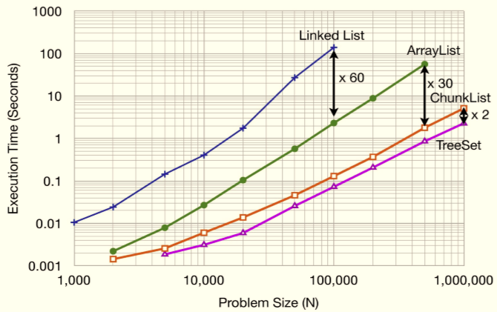
Asymptotic analysis
Repeat n times:
insert item into list in sorted order
search for some item
Thus, the asymptotic analysis for both is O(n²)
Real execution time from a 2.4 GHz Intel Core 2 Duo with a 2MB L2 cache and 3.25 GB of RAM running Java 6
ArrayList | LinkedList
O(n)
O(log n)
O(n)
O(n)
Note: log-log plot
<number>
Notes:
<number>

Slide 53
Why 60x slower??
Focus on the expensive operations:
ArrayList: move items in memory n calls to System.arraycopy()
LinkedList: iterate and compare n² calls to comparator/next
Memory:
ArrayList uses 3 times less memory than LinkedList (for the Java implementation)
More data is in the L1 cache, so faster performance
Bottom line: If asymptotic complexities of two approaches are the same, then real execution times do matter!
<number>
Notes:
<number>

Slide 54
Stacks
A stack is a data structure that supports inserting and deleting data, with a special property
The LIFO property: the Last item In is the First item Out
Example: Activation records
Insert: push onto the stack
Delete: pop from the stack
Signature for pop: Stack pop(Stack s, int *data);
Additional operations:
Is the stack empty?
If not, what is the top item in the stack (peek)
<number>
Notes:
<number>

Slide 55
Stack Implementation
With ArrayList2 implementation:
push as append O(1) time usually, O(n) time worst case
pop as deleteLast O(1) time
isEmpty?
peek?
With LinkedList1 implementation:
push as prepend O(1) time
pop as deleteFirst O(1) time
isEmpty?
peek?
<number>
Notes:
<number>

Slide 56
Queues
A queue is a data structure that supports inserting and deleting data, with a special property
The FIFO property: the First item In is the First item Out
Example: A queue of customers
Insert: enqueue
Delete: dequeue
Additional operations:
Is the queue empty?
Concatenate two queues
Question: Can each of these operations be implemented in O(1) time using any one of our list data structures?
<number>
Notes:
<number>

Slide 57
Stacks and Queues
A stack is a data structure that supports inserting and deleting data, with a special property (LIFO): the Last item In is the First item Out
Insert: push onto the stack
Delete: pop from the stack
A queue is a data structure that supports inserting and deleting data, with a special property (FIFO): the First item In is the First item Out
Insert: enqueue
Delete: dequeue
Fast implementations:
Stack: LinkedList1 will have O(1) worst-case performance
Queue: LinkedList2 will have O(1) worst-case performance
<number>
Notes:
<number>

Slide 58
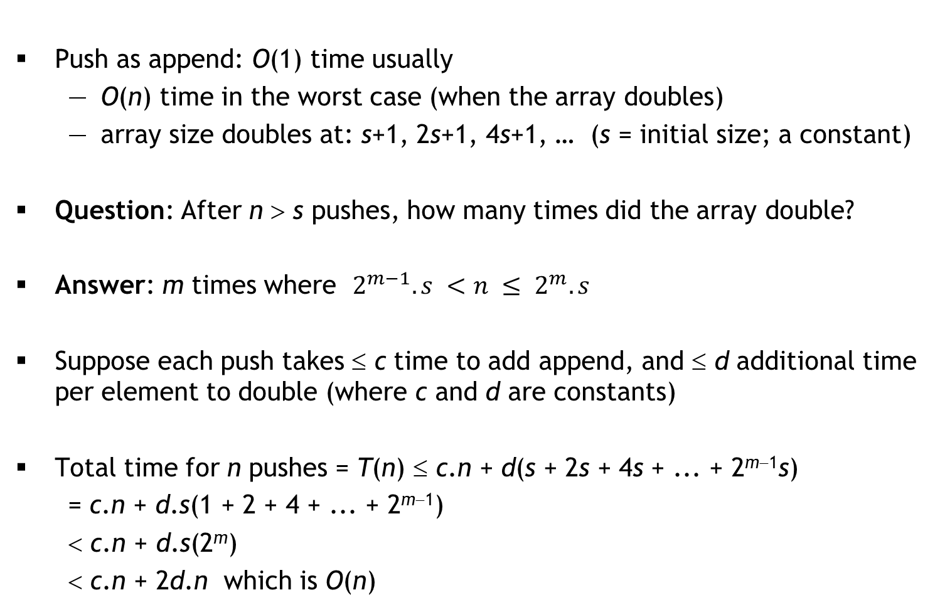
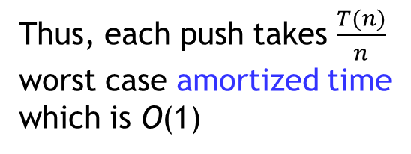
ArrayList2 implementation of Stack
Push as append: O(1) time usually
O(n) time in the worst case (when the array doubles)
array size doubles at: s+1, 2s+1, 4s+1, … (s = initial size; a constant)
Question: After n > s pushes, how many times did the array double?
Answer: m times where
Suppose each push takes ≤ c time to add append, and ≤ d additional time per element to double (where c and d are constants)
Total time for n pushes = T(n) ≤ c.n + d(s + 2s + 4s + ... + 2^{m−1}s)
= c.n + d.s(1 + 2 + 4 + ... + 2^{m−1})
< c.n + d.s(2^{m})
< c.n + 2d.n which is O(n)
Thus, each push takes
worst case amortized time
which is O(1)
<number>
Notes:
<number>

Slide 59
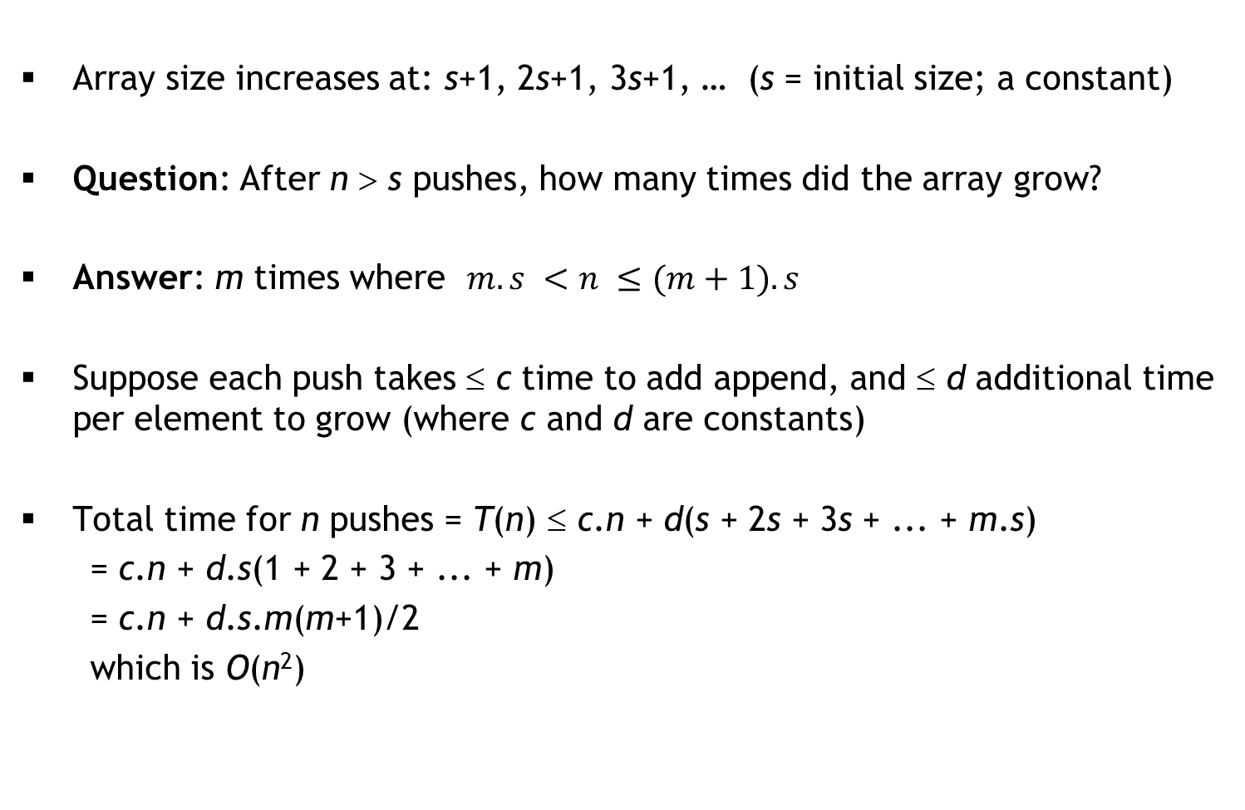

ArrayList2: growing by constant instead of doubling
Array size increases at: s+1, 2s+1, 3s+1, … (s = initial size; a constant)
Question: After n > s pushes, how many times did the array grow?
Answer: m times where
Suppose each push takes ≤ c time to add append, and ≤ d additional time per element to grow (where c and d are constants)
Total time for n pushes = T(n) ≤ c.n + d(s + 2s + 3s + ... + m.s)
= c.n + d.s(1 + 2 + 3 + ... + m)
= c.n + d.s.m(m+1)/2
which is O(n²)
Thus, each push takes
worst case amortized time
which is O(n)
<number>
Notes:
<number>

Slide 60
Interview Questions
Standard ones:
Given two sorted queues Q1 and Q2, create a new sorted queue containing the elements of Q1 and Q2 in sorted order
Given a Stack implementation, implement a Queue
Given a Queue implementation, implement a Stack
Given a linked list of unknown length, determine whether the last element points to NULL, or links back to some earlier node
Dr. Ram’s question: What data structure will you use for Sudoku?
My question: We want to maintain a growing list of integers and support “find” and “insert” operations. For “find”, the data structure must have excellent worst-case performance, but “insert” can be occasionally expensive so long as the amortized time is good.
Idea: Maintain two ArrayLists: Sorted (large) and Unsorted (small). New data is appended to Unsorted in O(1) time, and find searches for data in Sorted using binary search and Unsorted using linear search. When Unsorted gets large, sort Unsorted and merge with Sorted.
<number>
Notes:
<number>

Slide 61
Stacks Application: Evaluating Expressions
Write a function to evaluate these expressions:
Infix notation
A + B
(A + B) * C
A * B + C
A + B * C
Maintain a stack S (initially empty)
For each token t:
If t is an operand, push(S, t)
If t is an operator:
pop the top 2 operands p1 and p2 from the stack
push(S, p2 t p1)
Pop the stack to produce the answer
Postfix notation
A B +
A B + C *
A B * C +
A B C * +
<number>
Notes:
<number>

Slide 62
Infix to Postfix
Create an empty stack S for operators
Create an empty list L for output
For each token t:
If t is an operand, append(L, t)
If t is a left parenthesis, push(S, t)
If t is a right parenthesis:
pop S until the corresponding left parenthesis is removed
append each popped operator to L
If t is an operator:
repeatedly peek S, pop any operators of high precedence than t and append them to L
push(S, t)
Pop any remaining operators in S and append them to L
<number>
Notes:
<number>

Slide 63
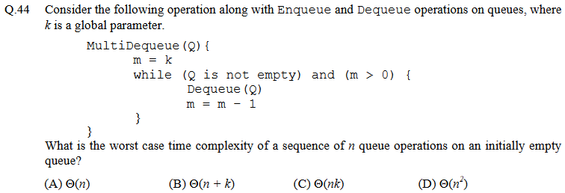
GATE question (CS, 2013)
<number>
Notes:
<number>

Slide 64
Interview Question
Consider this infinite 2D grid:
You are given:
the initial point
up() and right() functions
Goal: find the target
Your friend’s solution:
target
initial
D = empty(); // stack/queue
insert(D, initial); // push/enqueue
while(!isEmpty(D)) {
p = delete(D); // pop/dequeue
if(p == target) { return; }
insert(D, right(p));
insert(D, up(p));
}
<number>
Notes:
<number>

Slide 65
Deques
A double-ended queue (or deque) is a queue that supports enqueue and dequeue operations at both the front and rear of the queue:
enqueue_f, enqueue_r
dequeue_f, dequeue_r
Linked list implementation of a deque:
typedef struct linkedlist2 {
Node *head;
Node *tail;
int listSize;
} LinkedList2;
head
tail
dequeue_f
head = head->next
enqueue_r
tail->next =
new node
enqueue_f
p = new node
p->next = head
head = p
<number>

Slide 66
Linked list implementation: dequeue_r
void dequeue_r(LinkedList2 *dq, int *ans) {
if(dq == NULL || dq->head == NULL) { return; }
Node *p = dq->head; Node *q = dq->tail;
if(p == q) {
dq->head = dq->tail = NULL;
} else {
while(p->next != q) { p = p->next; }
p->next = NULL;
dq->tail = p;
}
dq->listSize--;
if(ans != NULL) { *ans = q->data; }
free(q);
}
O(n)
<number>

Slide 67
Faster implementation: doubly linked lists
typedef struct dllnode {
int data;
struct dllnode *prev;
struct dllnode *next;
} DLL_node;
We can now implement a deque as follows:
typedef struct deque {
DLL_node *head;
DLL_node *tail;
int size;
} Deque;
<number>

Slide 68
Fill in the details!
DLL_node *makeDLL_node(int, DLL_node *, DLL_node *);
Deque *enqueue_f(Deque *dq, int data) {
DLL_node *p = makeDLL_node(data, NULL, NULL);
if(p == NULL) { return NULL; }
if(dq == NULL) {
dq = (Deque *) malloc(sizeof(Deque));
if(dq == NULL) { free(p); return NULL; }
dq->head = dq->tail = p; dq->size = 1;
} else {
if(dq->head == NULL) { dq->head = dq->tail = p; }
else {
p->next = dq->head;
dq->head->prev = p;
dq->head = p;
}
dq->size++;
}
return dq;
}
<number>

Slide 69
One more!
void dequeue_r(Deque *dq, int *ans) {
if(dq == NULL || dq->head == NULL) { return; }
DLL_node *q = dq->tail;
if((dq->tail = q->prev) == NULL) {
dq->head = NULL;
}
dq->size--;
if(ans != NULL) { *ans = q->data; }
free(q);
}
<number>

Slide 70
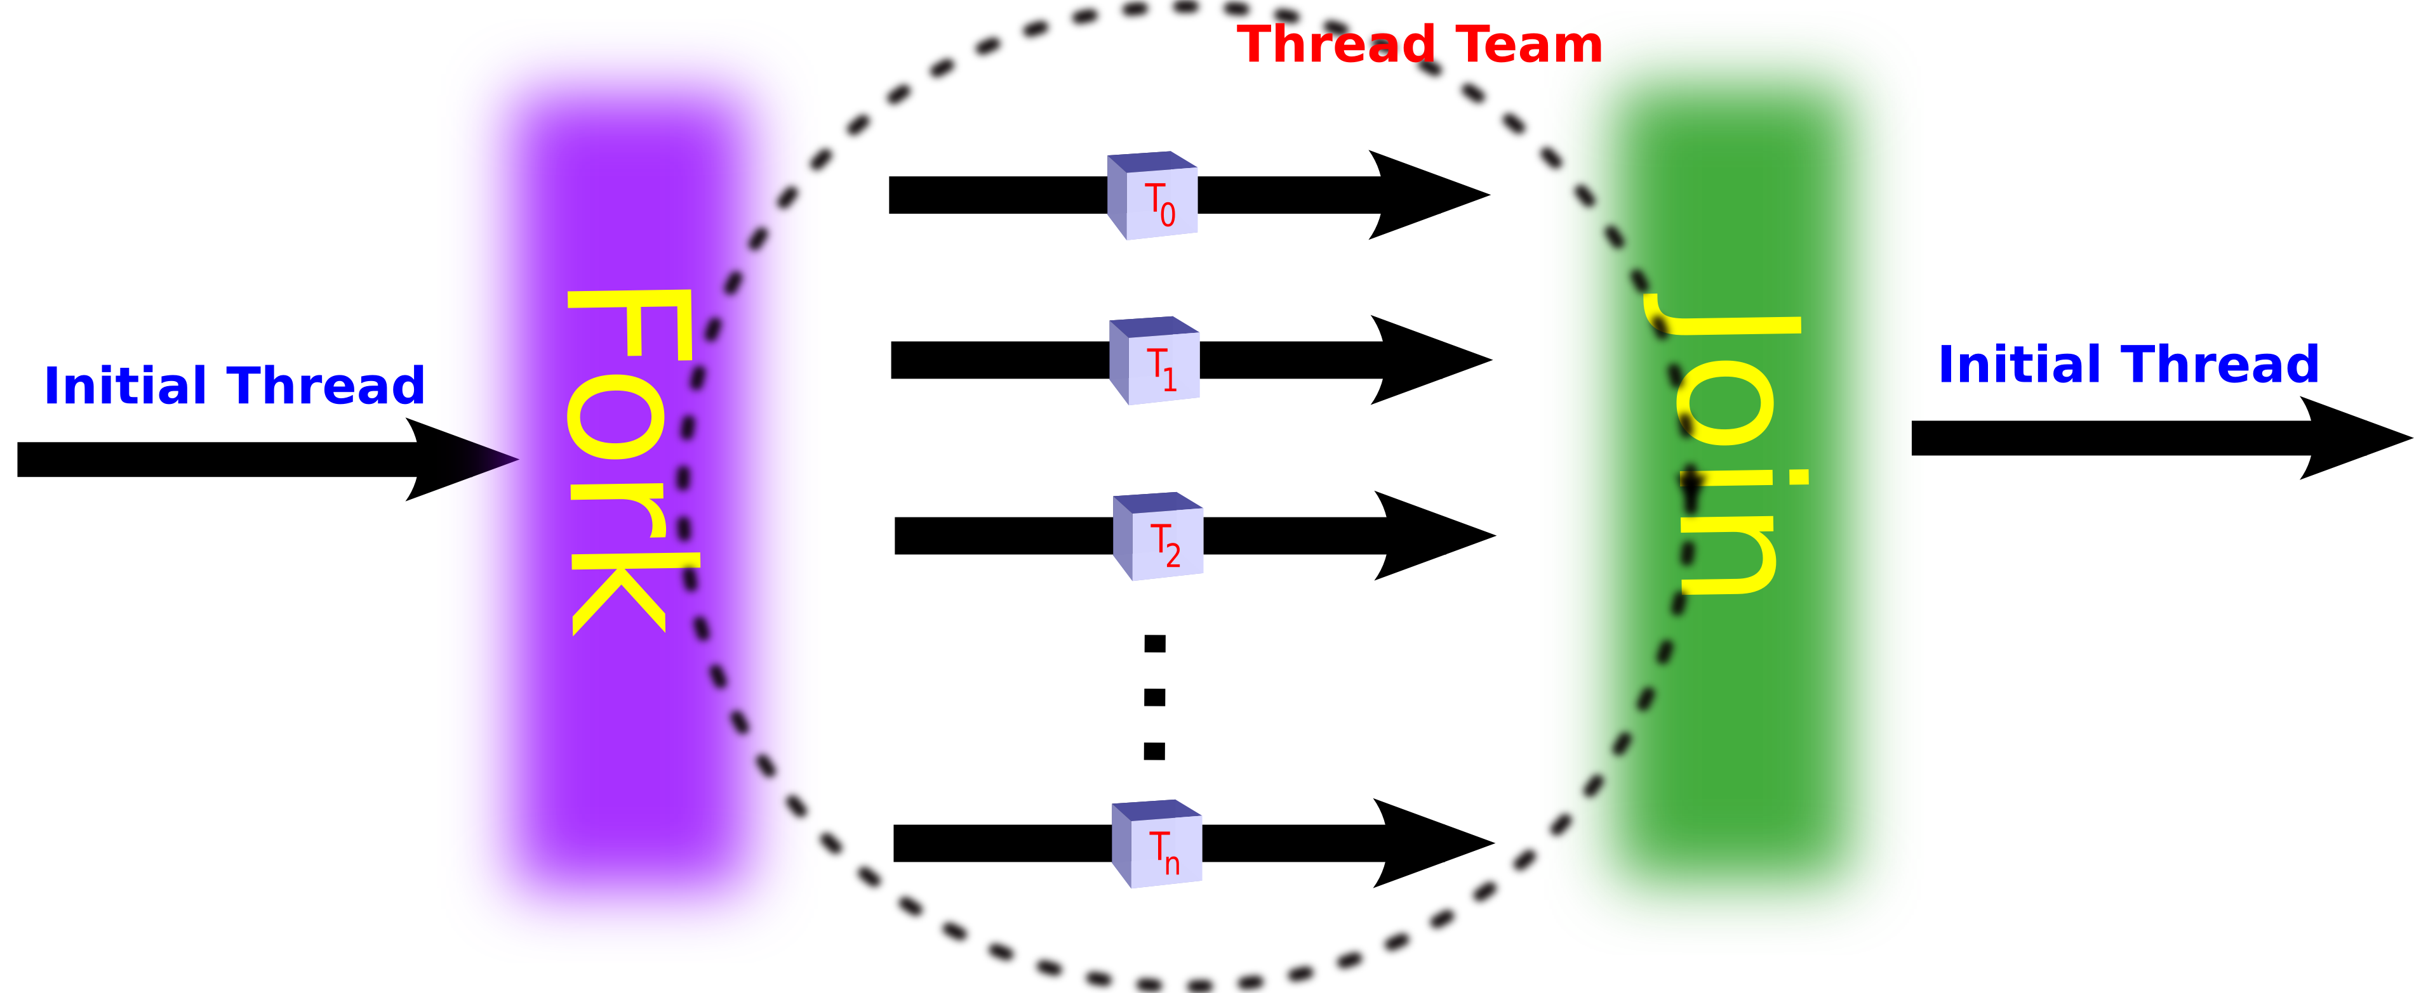
An interesting application: Work stealing
:
for(i = 0; i < N; i++) {
a[i] = f(i); // f() is an expensive computation
}
:
Key idea: If possible, share expensive work across multiple processors
:
parallel_for(i = 0; i < N; i++) {
a[i] = f(i);
}
:
Fork-join model:
Task scheduler needs to
assign iterations to processors
<number>
<number>

Slide 71
Sharing the workload
:
for(i = 0; i < N; i++) {
a[i] = f(i); // f() is an expensive computation
}
:
Naïve strategy: Split the iterations evenly among processors
e.g., if there are 4 processors P₁, P₂, P₃, P₄ then
does very poorly if some iterations take much longer than others
Task scheduler cannot predict this!
Even if it could, finding the optimal split is NP-hard
0 | N/4 | N/2 | 3N/4
P₁
P₂
P₃
P₄
<number>
<number>

Slide 72
Work-Stealing Heuristic
Each available processor will maintain a deque of tasks (sub-ranges)
P₁’s deque:
P₁ processes its deque bottom-up
if P₁ done, it steals from top of P_{random}’s deque
An improvement:
0 | N/4 | N/2 | 3N/4
P₁
P₂
P₃
P₄
0
N/8
3N/16
0
N/8
N/16
0
≤ grainsize
0
N/8
N/8
0
N/16
0
<number>

Slide 73
Two Pointers per Node
Recall that our doubly-linked lists require two pointers per DLL_Node:
typedef struct dllnode {
data_t data;
struct dllnode *prev;
struct dllnode *next;
} DLL_node;
Observation: Suppose A_{i} is the address of the i^{th} node in the DLL
We often maintain a pointer p to the i^{th} node
What if we maintained consecutive pointers p and q?
If sizeof(data_t) is the size
of a pointer, that is 3× space!
data_{i}
A_{i−1}
A_{i+1}
Redundant data
data_{i+1}
A_{i}
A_{i+2}
p
A_{i}
q
A_{i+1}
<number>

Slide 74
XOR trick!
A new definition of DLL_Node:
typedef struct dllnode {
data_t data;
int xor_PN;
} DLL_node;
To compute A_{i−1}: p->xor_PN ^ q
To compute A_{i+2}: p ^ q->xor_PN
Interview question: How do you do this in Java?
Assuming sizeof(pointer)
= sizeof(int)
O(1) space
overhead!
p
A_{i}
data_{i}
A_{i−1}⊕A_{i+1}
q
A_{i+1}
data_{i+1}
A_{i}⊕A_{i+2}
<number>

Slide 75
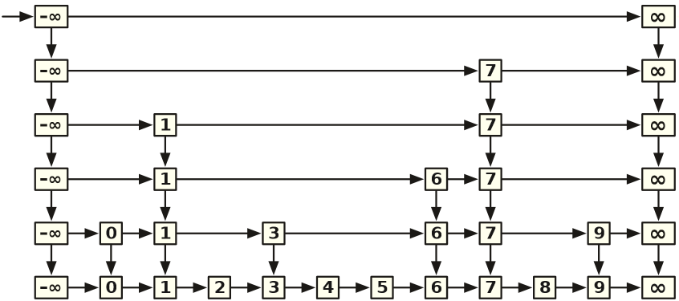
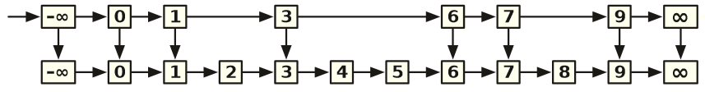
Another clever use: Skip Lists
Suppose we want to maintain a set of integers and support Find, Insert and Delete operations efficiently
Sorted list?
Option 1: ArrayList will do Find in O(log n) time, but Insert/Delete will each take O(n) time
Option 2: LinkedList will require O(n) time in the worst case for all
Option 3: Short-cuts (instead of prev, maintain a down pointer)
Find(5) vs. Find (6)
Worst case for Find?
Now extend this idea recursively!
Worst-case running time: O(n)
Expected worst-case: O(log n)
<number>

Slide 76
Practice Exam 1
You are allowed to bring ONE A4-sized cheat sheet
double-sided, handwritten only
The exam will have FOUR questions (30 points)
Question 1 (Bad recursion, List): 4 points; multi-select (like independent T/F questions, but selecting all/deselecting all will earn 0 points)
Question 2 (Asymptotic analysis, List): 6 points; multi-select
Question 3 (C programming, DLL): 10 points (no penalty for minor syntax errors)
Question 4 (Stack or Queue ADT): 5+5 points; critique your friend’s prototype and suggest a better one
<number>
Notes:
<number>

Slide 77
Question 1 (4 points)
Consider this INCORRECT implementation of the forall function in the List ADT defined in class:
1: ListEntry forall(List list,
int(*task)(int, void*),
void *args) {
2: ListEntry s = start(list);
3: if(s == NULL) { return NULL; }
4: if(!task(getData(s), args)) {
5: return list;
6: }
7: return forall(next(list, s), task, args);
8: }
The code is incorrect because:
A) list can be NULL in Line 2
B) s can be NULL in Line 4
C) there is a logical error in Line 5
D) Line 7 can cause infinite recursion
<number>
Notes:
<number>

Slide 78
Question 2 (6 points)
The following function returns the first position of data in list, or returns -1 if no such position exists:
int findPosition(List list, int data) {
ListEntry e = start(list);
if(e == NULL) { return -1; }
for(int i = 0; i < size(list); ++i) {
if(getData(e) == data) { return i; }
e = next(list, e);
}
return -1;
}
The worst-case running time on a list with n elements is
A) O(n) with ArrayList1 implementation
B) O(n) with ArrayList2 implementation
C) O(n) with LinkedList1 implementation
D) O(n) with LinkedList2 implementation
<number>
Notes:
<number>

Slide 79
Question 3 (10 points)
Complete the following C function:
int sameDLL(DLL_node *p, DLL_node *q) {
// Assume that p != NULL && q != NULL
// Return 1 if p and q are part of the
// same doubly-linked list, and return
// 0 otherwise
}
<number>
Notes:
<number>

Slide 80
Question 4 (5+5 points)
Consider the Stack ADT. We want to add a new operation multi_pop that pops the top k data items from the stack and stores them in a List (items appear in the list in the order in which they were popped). The List should be NULL if the operation fails for any reason, or if k ≤ 0.
Critique the following function prototype proposed by your friend:
List multi_pop(Stack s, int k);
Based on your critique, propose a better prototype for this function.
<number>
Notes:
<number>

